Slide 1


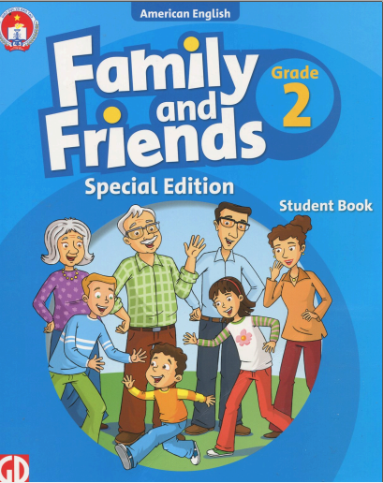

THE PEOPLE’S COMMITTEE OF DISTRICT 3
NGUYỄN VIỆT HỒNG PRIMARY SCHOOL
Week 26: Unit 10
Lesson 1,2,3

Slide 2

Sing the song

Slide 3


REVIEW
Notes:
TEN LITTLE INDIANS SONG

Slide 4
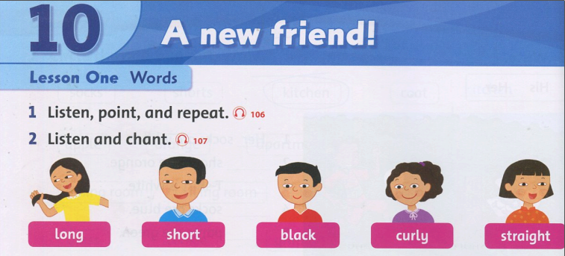
Student Book, page 68

Slide 5
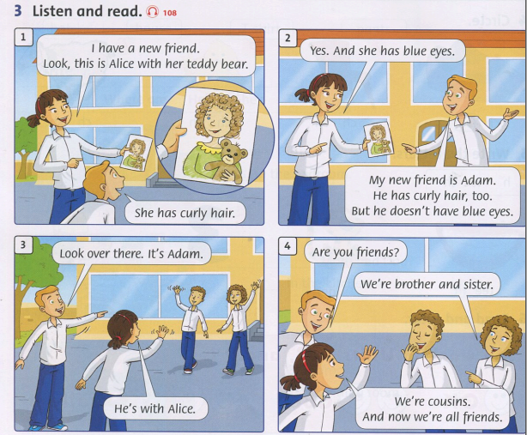

Slide 6
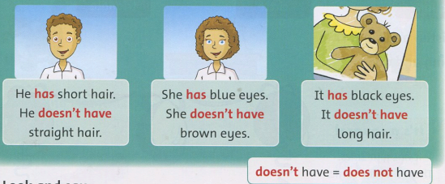
Grammar
Let’s learn:
(+) He/ She/It + has + ….
(-) He/ She/It + doesn’t have + ….

Slide 7
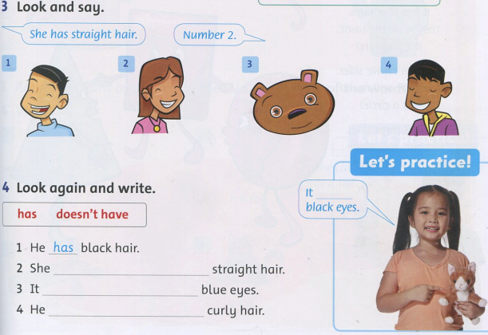
Gợi ý:
Number 1: He has black hair.
Number 2: She has straight hair.
Number 3: It doesn’t have blue eyes.
Number 4: He doesn’t have curly hair.

Slide 8
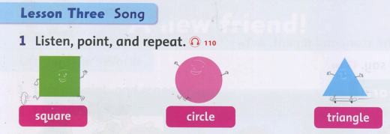
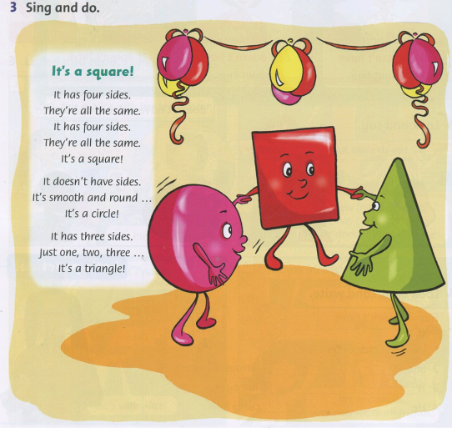

Slide 9
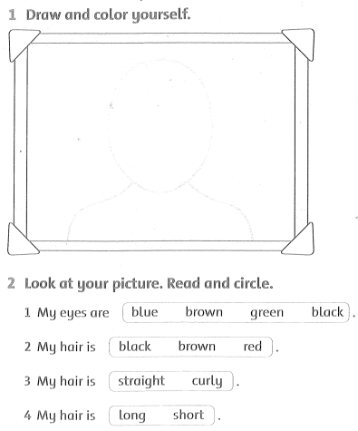
Workbook, page 68

Slide 10
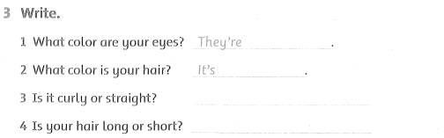
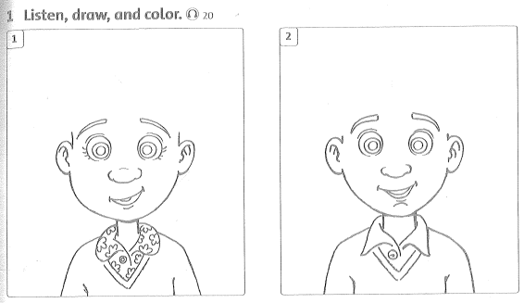

Slide 11
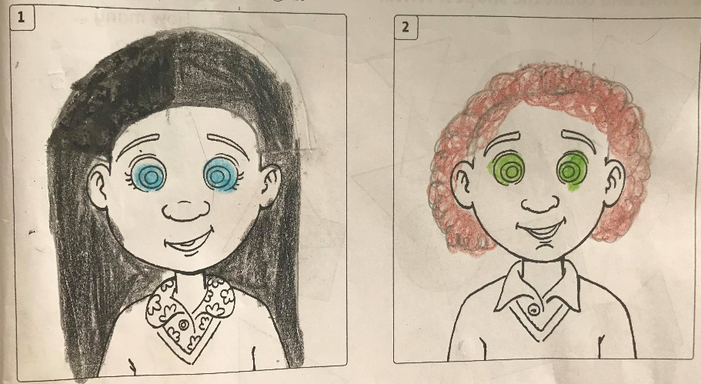
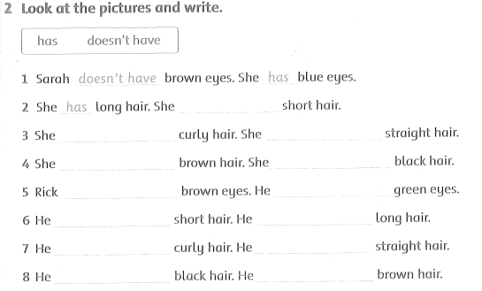
Sarah
Rick

Slide 12
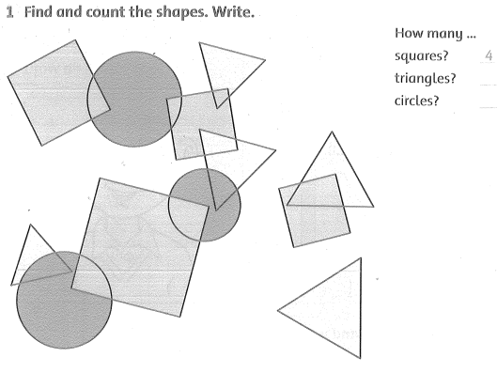
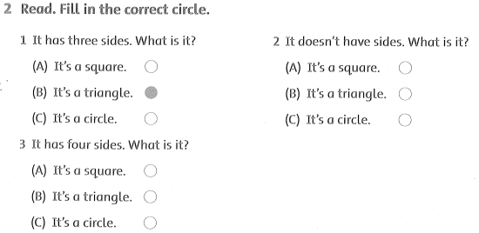

Slide 13
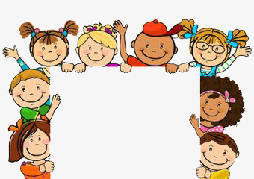
Thank you
very much.
Good bye!

